Slide 1
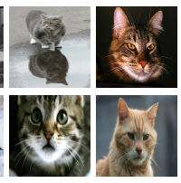
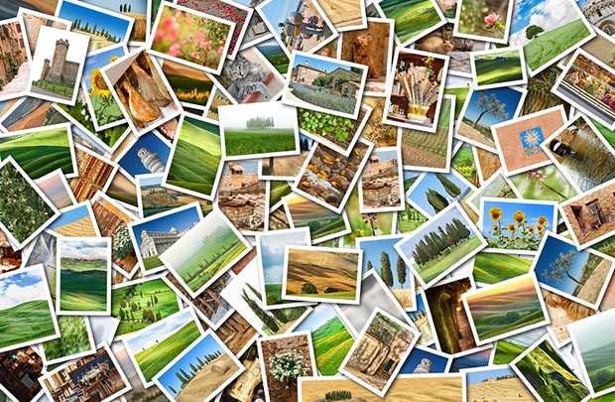
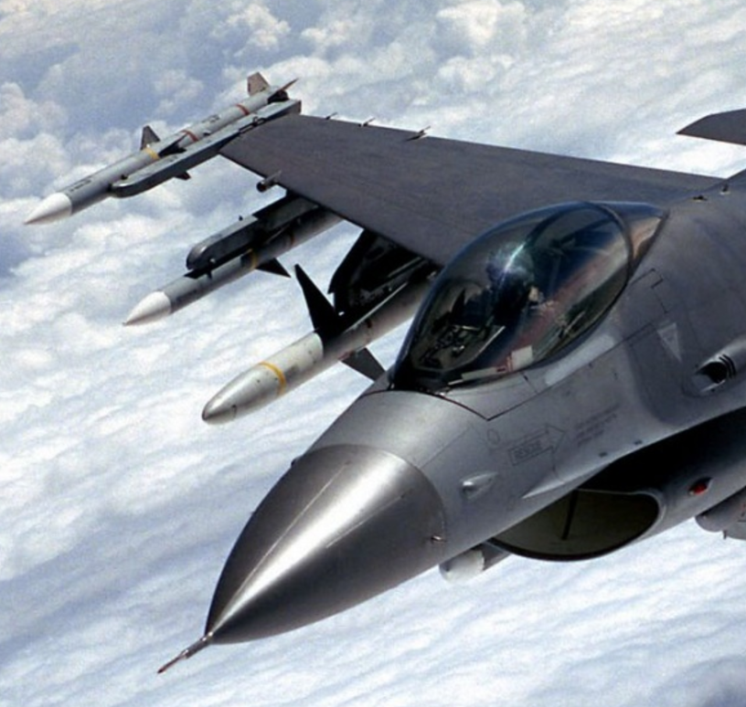
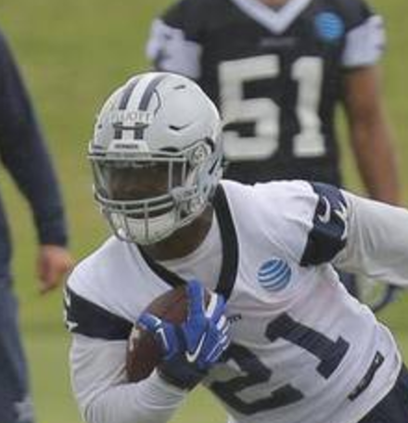
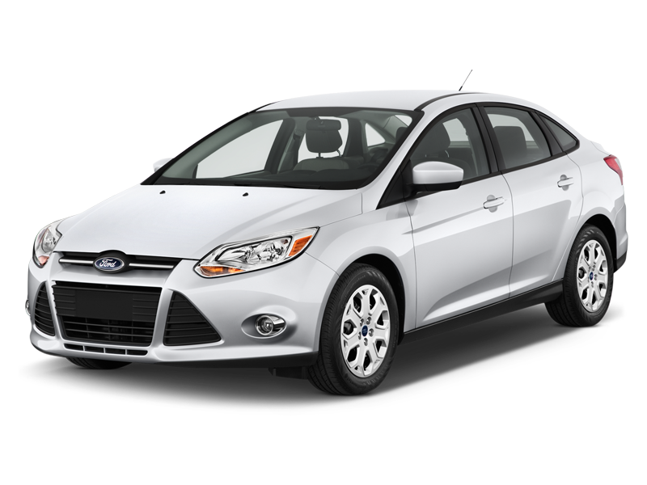

Labels
Cat
Dog
Car
Tree
Jet
Runner
Neural Network
Training Images

Slide 2
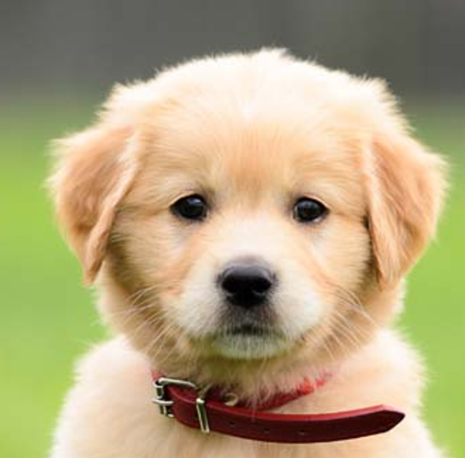
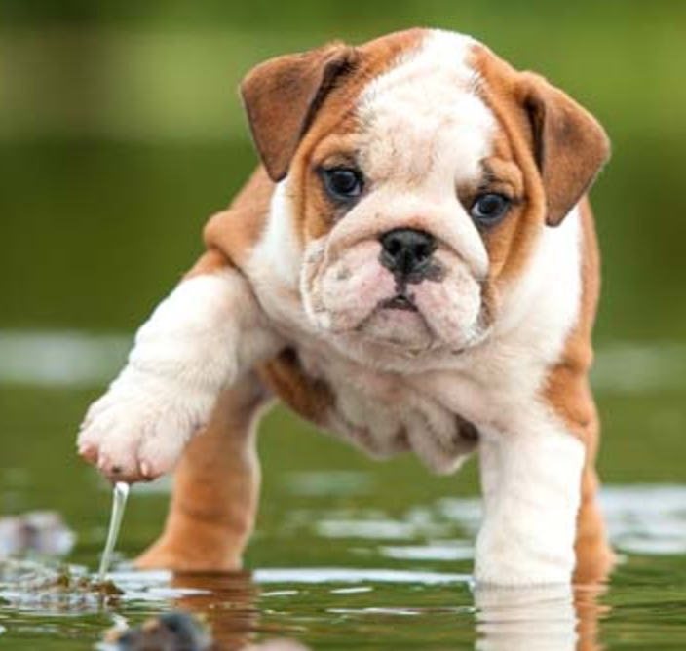
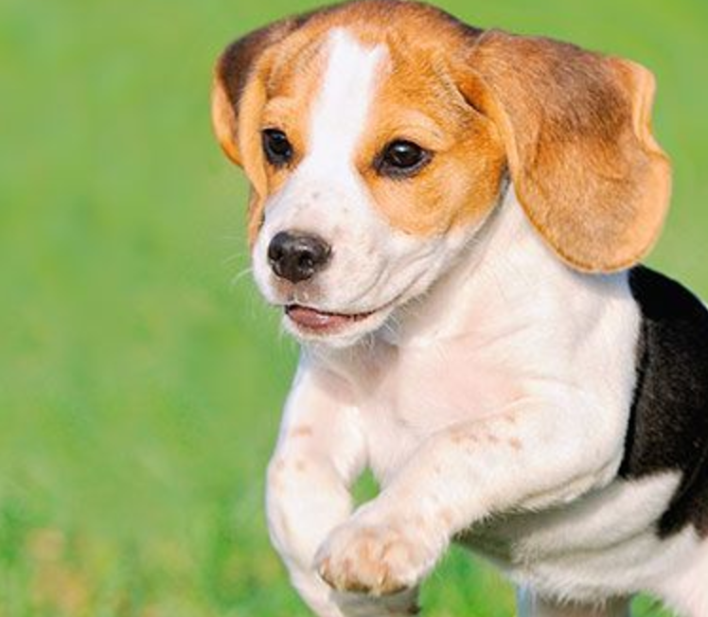
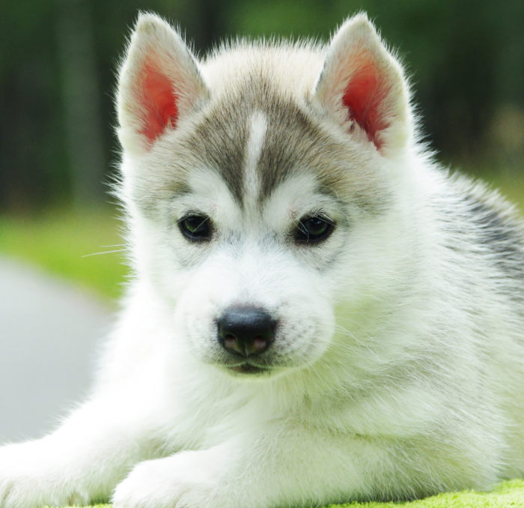
Labels
Cat
Dog
Car
Tree
Jet
Runner
Neural Network
Sample Images
Training Images

Slide 3
Labels
Cat
Dog
Car
Tree
Jet
Runner
Sample Labels
Neural Network
Sample Images
Training Images

Slide 4
Labels
Cat
Dog
Car
Tree
Jet
Runner
Sample Labels
Neural Network
Sample Images
Training Images

Slide 5
Labels
Cat
Dog
Car
Tree
Jet
Runner
Sample Labels
Neural Network
Sample Images
Training Images

Slide 6
Labels
Cat
Dog
Car
Tree
Jet
Runner
Sample Labels
Neural Network
Sample Images
Training Images

Slide 7
Labels
Cat
Dog
Car
Tree
Jet
Runner
Neural Network
Training Images

Slide 8
Labels
Cat
Dog
Car
Tree
Jet
Runner
Neural Network
Sample Images
Training Images

Slide 9
Labels
Cat
Dog
Car
Tree
Jet
Runner
Sample Labels
Neural Network
Sample Images
Training Images

Slide 10
Labels
Cat
Dog
Car
Tree
Jet
Runner
Sample Labels
Neural Network
Sample Images
Training Images

Slide 11
Labels
Cat
Dog
Car
Tree
Jet
Runner
Sample Labels
Neural Network
Sample Images
Training Images

Slide 12
Labels
Cat
Dog
Car
Tree
Jet
Runner
Sample Labels
Neural Network
Sample Images
Training Images

Slide 13
Labels
Cat
Dog
Car
Tree
Jet
Runner
Sample Labels
Neural Network
Sample Images
Training Images

Slide 14
ImageNet / Visual Genome
Cat
Dog
Car
Tree
Final Layer
1000 Labels
Deep Network
(19 Layers)
VS
Open Source Metadata Tags
Plane
Phone
Canine
Cat
Dog
Car
Tree
K9
Vase
Book
Final Layer
(400k+ Tags)
Deep Network
(19 Layers)

